Slide 1
Final Exam Review
English 12

Slide 2
Idiom:
a group of words established by usage as having a meaning not deducible from those of the individual words (e.g., rain cats and dogs, see the light ).

Slide 3
Parallel Structure:
Parallel structure means using the same pattern of words to show that two or more ideas have the same level of importance. This can happen at the word, phrase, or clause level. The usual way to join parallel structures is with the use of coordinating conjunctions such as "and" or "or."

Slide 4
Shakespearean Sonnet
a type of sonnet much used by Shakespeare, written in iambic pentameter and consisting of three quatrains and a final couplet with the rhyme scheme abab cdcd efef gg.
There is usually a jump or shift in direction of the emotions or thought, usually somewhat after the middle of the Sonnet.

Slide 5
Soliloquy, Aside, and Monologue
Shakespeare’s characters often deliver these types of dramatic speeches.

Slide 6

What is a Soliloquy?
A soliloquy is a lengthy speech in which a character – usually alone on stage – expresses his or her thoughts to the audience.
https://youtu.be/91lJhEzMaH4

Slide 7
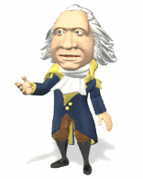
What is an Aside?
An aside is a brief remark by a character revealing his thoughts or feelings to the audience, unheard by the other characters.
Mr. Pynn

Slide 8

What is a Monologue?
A monologue, like a soliloquy, is a lengthy speech. However a monologue is addressed to other characters on stage, not to the audience.

Slide 9
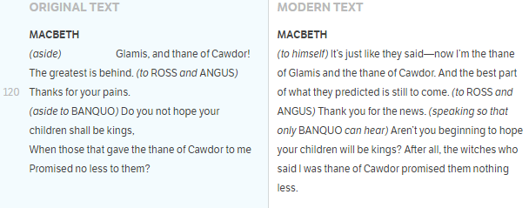
Macbeth’s Asides
Act 1, scene 3

Slide 10
Macbeth’s soliloquy
Act 1, scene 3
To be thus is nothing;
But to be safely thus. Our fears in Banquo
Stick deep; and in his royalty of nature
Reigns that which would be fear'd: 'tis much he dares;
And, to that dauntless temper of his mind,
He hath a wisdom that doth guide his valour
To act in safety. There is none but he
Whose being I do fear: and, under him,
My Genius is rebuk'd; as, it is said,
Mark Antony's was by Caesar. He chid the sisters
When first they put the name of king upon me,
And bade them speak to him: then prophet-like
They hail'd him father to a line of kings:
Upon my head they plac'd a fruitless crown,
And put a barren sceptre in my gripe,
Thence to be wrench'd with an unlineal hand,
No son of mine succeeding. If 't be so,
For Banquo's issue have I fil'd my mind;
For them the gracious Duncan have I murder'd;
Put rancours in the vessel of my peace
Only for them; and mine eternal jewel
Given to the common enemy of man,
To make them kings, the seeds of Banquo kings!
Rather than so, come fate into the list.
And champion me to the utterance!

