Slide 1
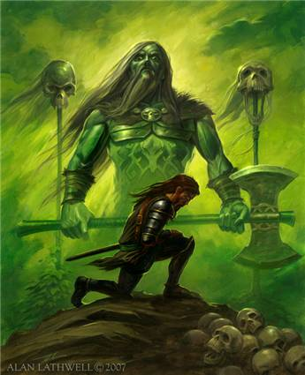
Sir Gawain and the Green Knight
12th grade

Slide 2
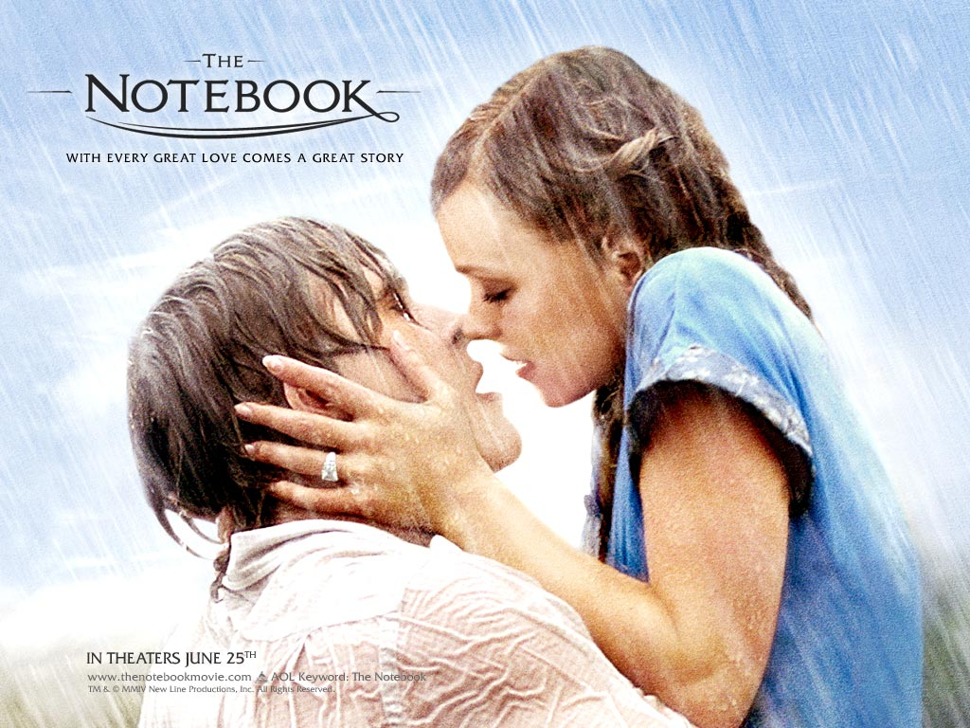
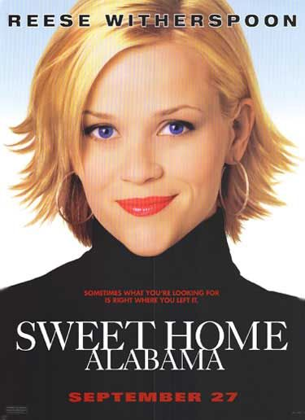
So what kind of story is this?
It’s a ROMANCE (but not like the movie The Notebook or Sweet Home Alabama).
ROMANCE:
a narrative set in a world of pure wish fulfillment
superhuman heroes fight and almost always conquer the forces of evil
the hero undertakes a hard journey in search of something valuable (a quest…remember that?)

Slide 3
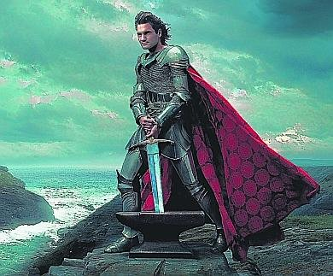
Main Characters…
King Arthur (ever heard of him?):
Legendary king of Britain
Husband of Guinevere
Uncle of Gawain
Over the famous Knights of the Round Table at Camelot
Brave, courageous, chivalrous

Slide 4
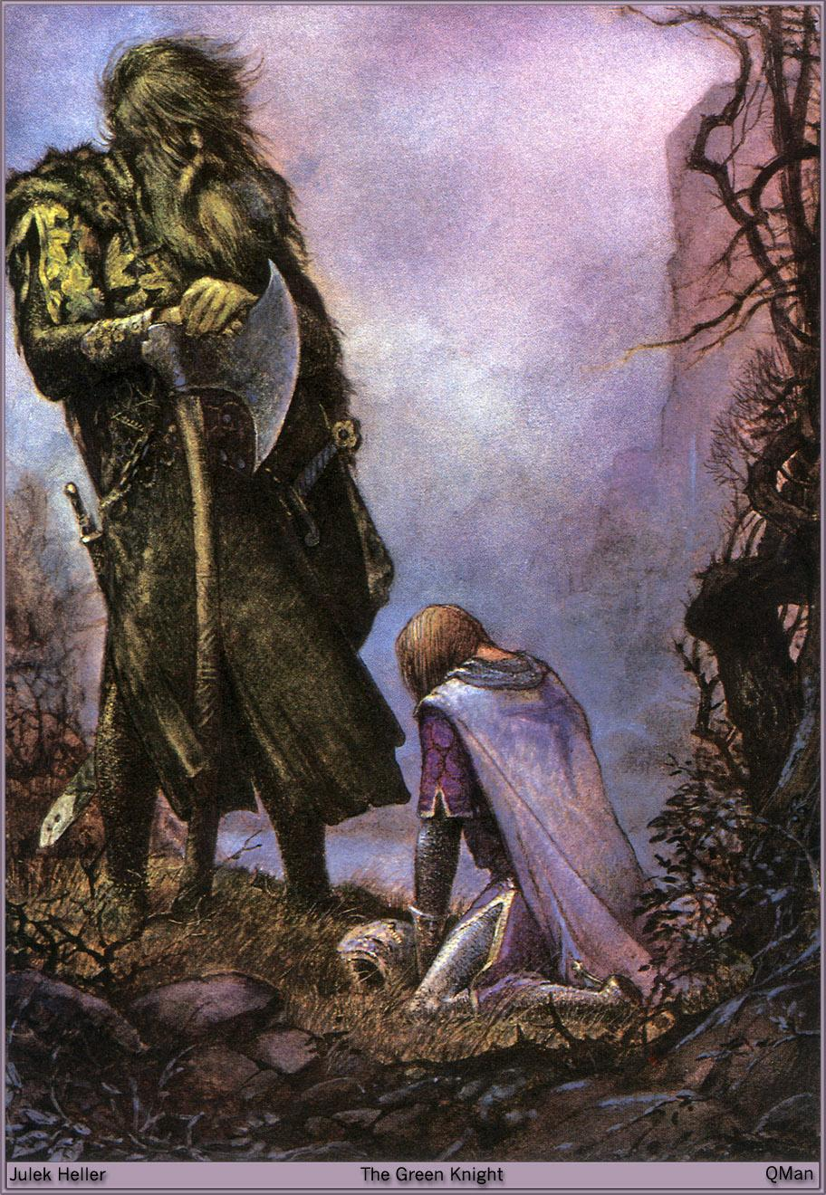
Main Characters…
Sir Gawain:
Arthur’s nephew and one of the most loyal, brave knights
Follows the chivalrous code (humility, piety, integrity, loyalty, honesty)
Courtly lover
One flaw: loves his life so much that he will lie to protect it (obviously breaking the code)

Slide 5
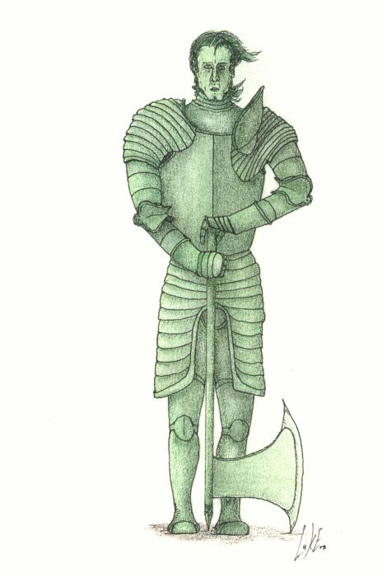
Main Characters…
The Green Knight:
Yes…he is a green man.
Huge guy with big muscles/carries a huge axe
Says he comes in friendship but proposes that someone step forward to play the “beheading game.”
Expects the knights to be courageous and step forward to play.

Slide 6
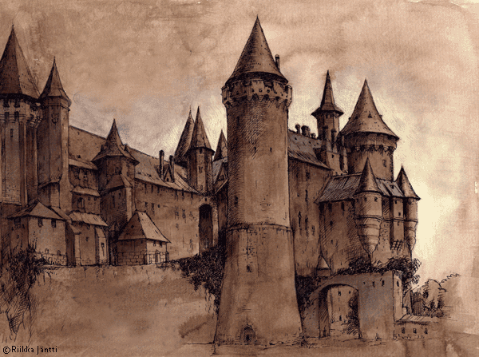
Other Characters…
Lord and Lady of the castle where Gawain stays for Christmas (The lady tries to seduce Gawain every day he is there.)
Queen Guinevere: Arthur’s wife and queen

Slide 7
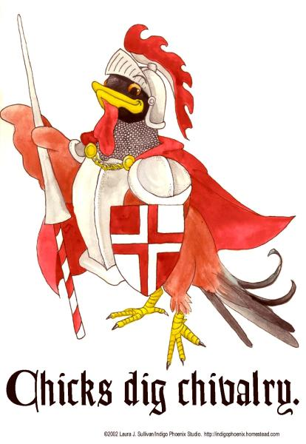
Major theme…
Chivalry:
The world of Sir Gawain and the Green Knight is governed by well-defined codes of behavior. The code of chivalry, in particular, shapes the values and actions of Sir Gawain and other characters in the poem. The ideals of chivalry come from the Christian concept of morality.

Slide 8
Major Theme…
Arthur's court depends heavily on the code of chivalry, and Sir Gawain and the Green Knight gently criticizes the fact that chivalry values appearance and symbols over truth. Arthur is introduced to us as the “most courteous of all,” indicating that people are ranked in this court according to their mastery of a certain code of behavior and good manners. When the Green Knight challenges the court, he mocks them for being so afraid of mere words, suggesting that words and appearances hold too much power over the company. The members of the court never reveal their true feelings, instead choosing to seem beautiful, courteous, and fair-spoken.

Slide 9
Major Theme…
The lesson Gawain learns as a result of the Green Knight's challenge is that, at a basic level, he is just a physical being who is concerned above all else with his own life. Chivalry provides a valuable set of ideals toward which to strive, but a person must above all remain conscious of his or her own mortality and weakness. Gawain's faults throughout this story teach him that though he may be the most chivalrous knight in the land, he is nevertheless human and capable of error.

Slide 10
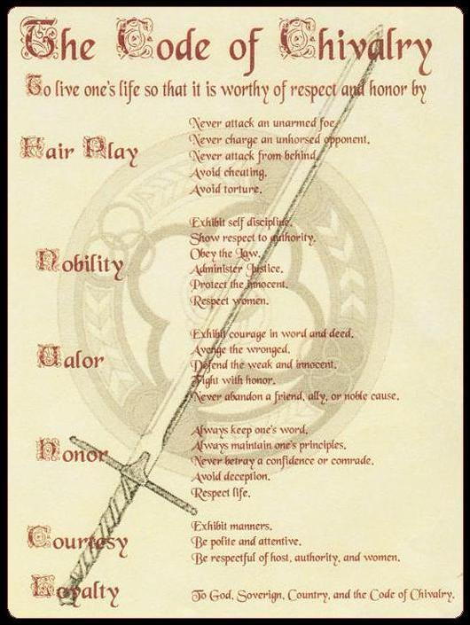

Slide 11
Setting up the story…
During a New Year's Eve feast at King Arthur's court, a strange figure, referred to only as the Green Knight, pays the court an unexpected visit. He challenges the group's leader or any other brave representative to a game. The Green Knight says that he will allow whomever accepts the challenge to strike him with his own axe, on the condition that the challenger find him in exactly one year to receive a blow in return.

Slide 12
Setting up the story…
Stunned, Arthur hesitates to respond, but when the Green Knight mocks Arthur's silence, the king steps forward to take the challenge. As soon as Arthur grips the Green Knight's axe, Sir Gawain leaps up and asks to take the challenge himself. He takes hold of the axe and, in one deadly blow, cuts off the knight's head. To the amazement of the court, the now-headless Green Knight picks up his severed head. Before riding away, the head reiterates the terms of the pact, reminding the young Gawain to seek him in a year and a day at the Green Chapel. After the Green Knight leaves, the company goes back to its festival, but Gawain is uneasy……..and away we go from there!

