Slide 1
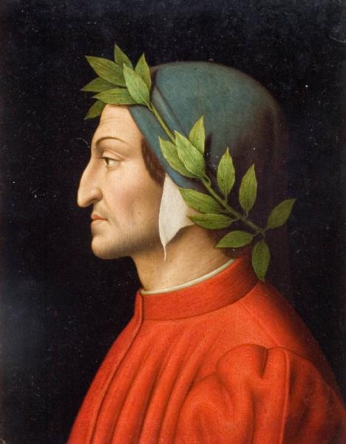
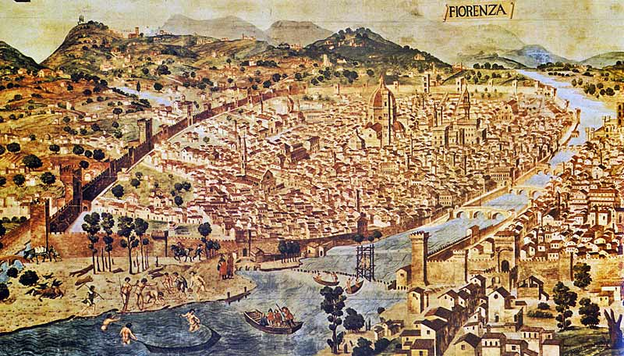
Dante Alighieri
“The Father of the Italian Language”
Born in 1265 in Florence, Italy
Died in 1321 in exile
Major Italian poet of the late Middle Ages
Played an instrumental role in establishing the national language of Italy

Slide 2
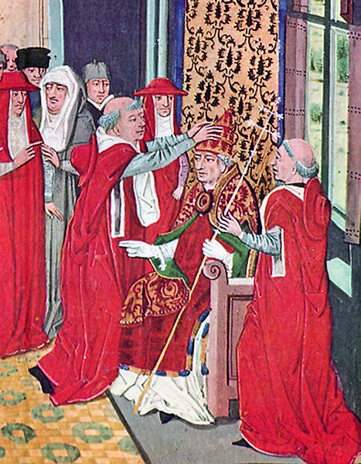
A Few Dante Facts:
Fell in love at age 9 to Beatrice, but…
Was betrothed at age 12 to another woman
Beatrice forever his “Love Inspiration” in his writing
Well-educated and studied classical literature at University
Became highly involved in politics and was named City Prior, Florence’s
highest position
White Guelphs and Black Guelphs were opposing parties in Florence
Dante was a member of the political party, the White Guelphs, which
opposed papal influence
Black Guelphs took power and permanently exiled Dante in 1302
If Dante returned to Florence he would be burned at the stake.

Slide 3
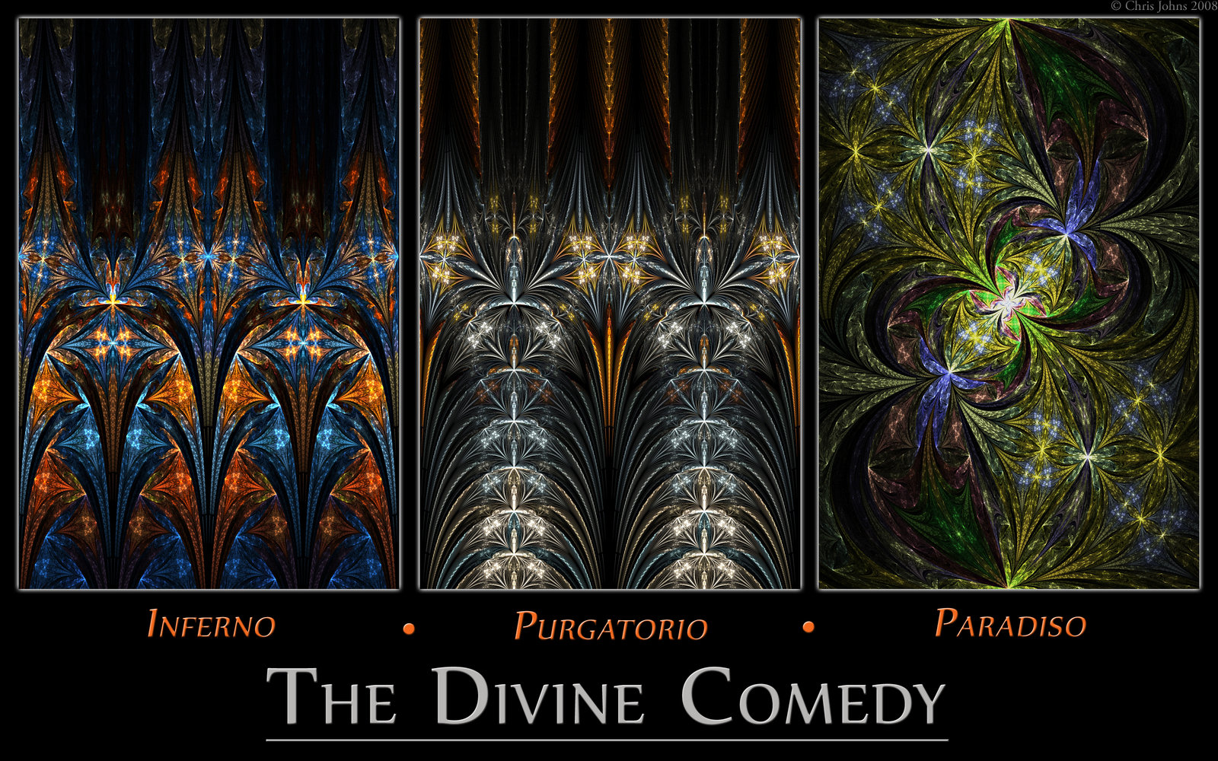
A Few Facts:
Dante began his master work in 1308 and completed it in 1320.
The Divine Comedy is comprised of 100 cantos.
A canto is a chapter in a long poem. It is an Italian word, derived from Latin “cantus” which means song.
3
Divisions of the World Beyond
HELL
33 Cantos
Purgatory
33 Cantos
Paradise/Heaven
33 Cantos

Slide 4
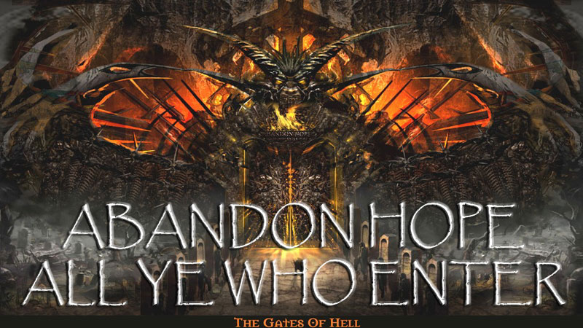
Dante’s Inferno:
A HELL of an Allegory
Can a Story Be More Than a Story?
Allegory Definition
a story, poem, or picture which can be interpreted to reveal a hidden meaning, typically a moral or political one
a literary device in which characters or events in a literary, visual, or musical art form represent or symbolize ideas and concepts
Two Ways to Read a Story:
Literally: Reading in a way in which you don’t look for hidden meanings or symbols.
Example: Dante and Virgil are two guys taking a stroll through Hell, seeing a variety of sinners who face gruesome punishments.
Allegorically: Reading in a way in which you are looking for hidden meanings from the author.
Example: Dante represents every man’s moments of weakness and descent into Hell. The sinners he encounters and punishments they face represent figures of Florence’s political corruption and how he felt about its moral decline of Florence. For Dante, life in Florence was his own Hell.

Slide 5
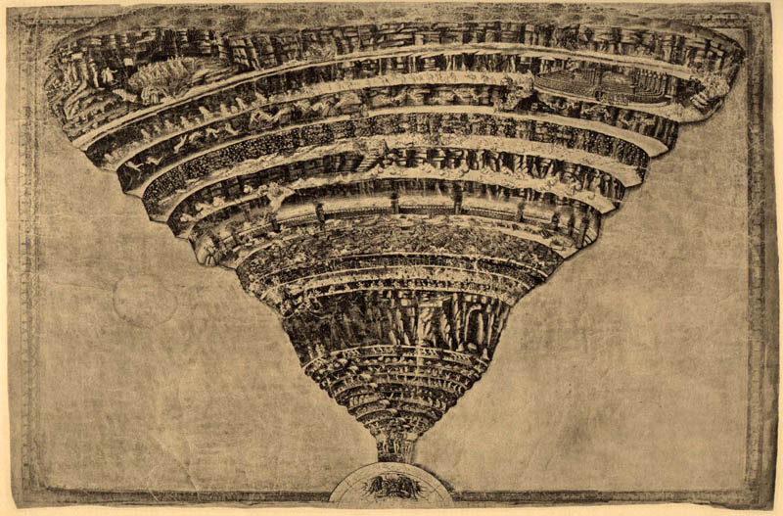
Dante’s Inferno
A Journey
through HELL
Funnel shape that extends all the way to the center of the earth
Arranged from Least Sinful to Most Sinful
Symbolic Retribution= Punishment symbolic or representative of the sin

Slide 6
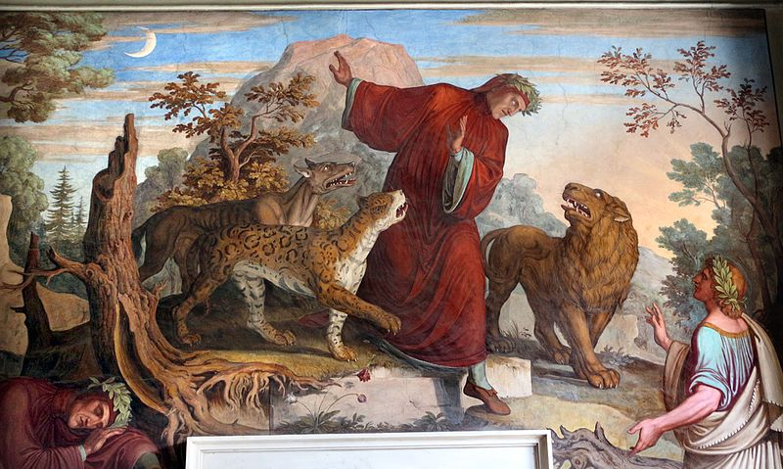
The Dark Wood of Error
“Worldiness”
Dante wakes from a deep sleep lost in the dark wood.
He awakens, tries to escape to Mount Joy, but encounters 3 beasts:
leopard = treachery & fraud
lion = violence
she-wolf = lack of self-control
He runs away and encounters a ghost who turns out to be the ancient Roman poet Virgil, Dante’s all-time favorite writer.
He tells Dante that Beatrice came down from Heaven to talk to him in Limbo. She told him that Dante was lost and wants Virgil to lead him back to the path of goodness.
Virgil agrees, but knows that the only way is down the center of the earth through Hell, then through Purgatory and eventually Heaven, if Dante is worthy.
More Symbols & Representations:
Dante = Every man
Virgil = Human Reason
Mount Joy = earthly immortality and happiness achieved by worthy actions on earth
Beatrice = Divine Love
The Adventure Begins…

Slide 7
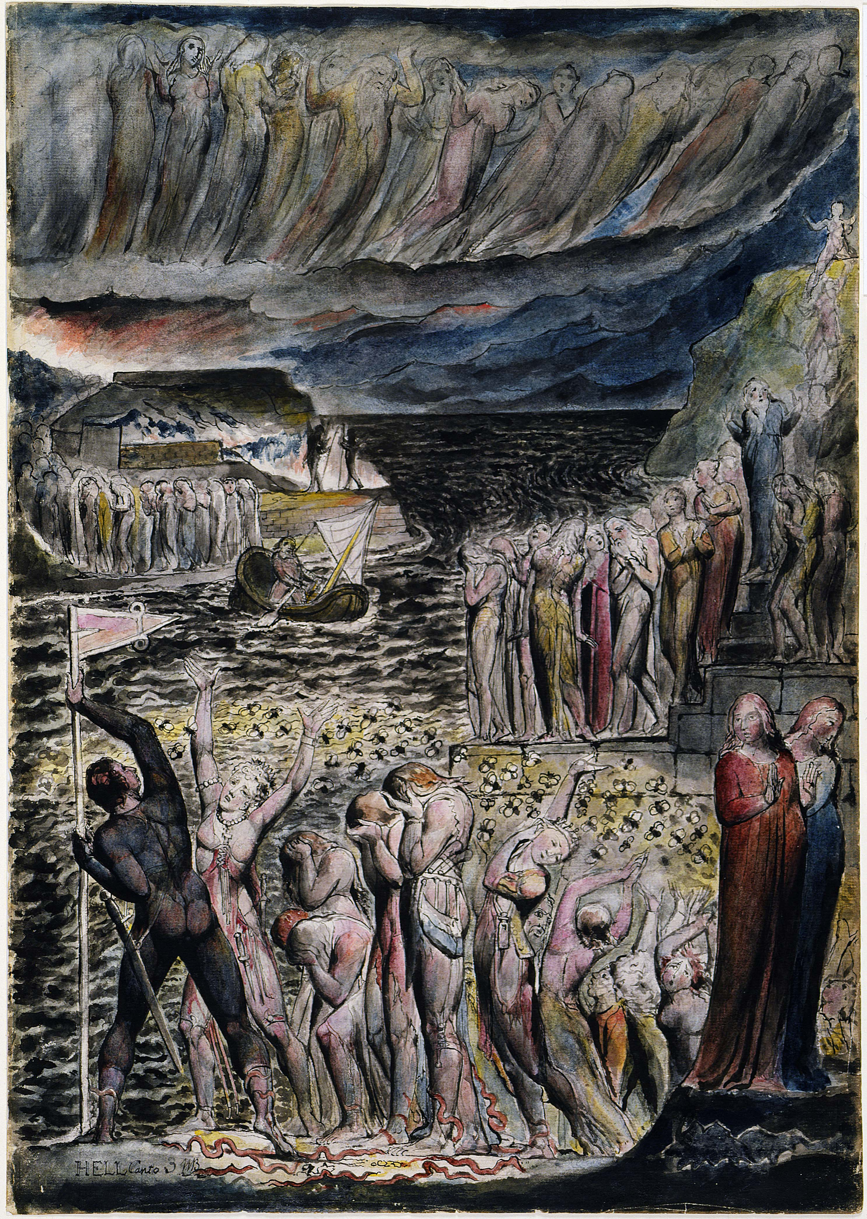
The Vestibule
Inhabitants: The Opportunists. They were people who were neither good not bad but were only for themselves.
Location: Just outside the realm of Hell.
Punishment: Through eternity, they must chase a waving banner while swarms of wasps sting them as they run across a maggot-covered ground.
More Symbols & Representations:
White Banner = the banner will elude them forever symbolizing the way they lived their lives on the winds of change
Wasps and Maggots = guilty conscience of how they lived

Slide 8
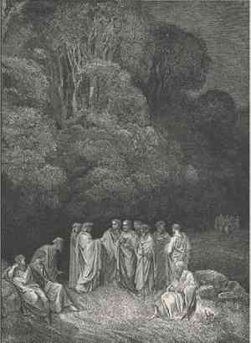
Circle 1: LIMBO
Dante and Virgil arrive in Limbo after entering the Gates of Hell
Limbo is the outer boundary of Hell just across the river Acheron
They are ferried across by Charon
They recognize classical poets, philosophers, Old Testament figures: Ovid, Homer, Horace, Julius Caesar, Moses, Abraham, Noah, etc…
Inhabitants: Virtuous pagans who lived just lives. They are condemned souls who were not sinful, but lacked the proper faith to enter Paradise, or who never received baptism.
This Circle is the only one where there is HOPE.

Slide 9
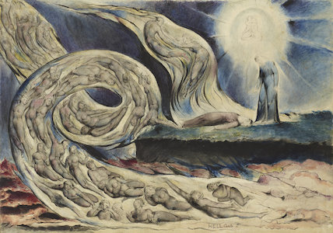
Circle 2: The Lustful

Slide 10
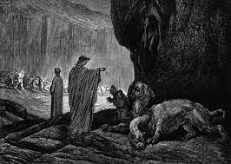
Circle 3: The Gluttonous

Slide 11
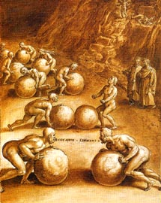
Circle 4: GREED

Slide 12
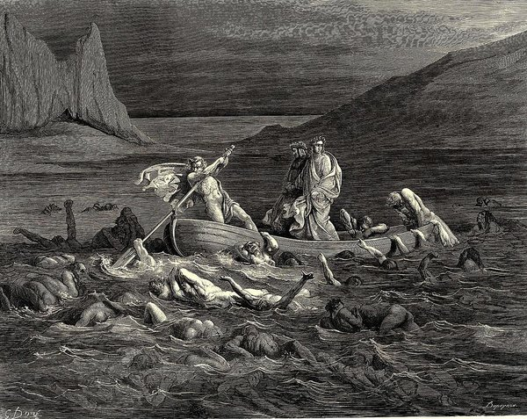
Circle 5: ANGER

Slide 13
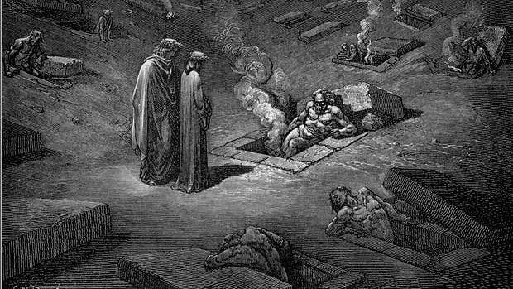
Circle 6: The Heretics

Slide 14
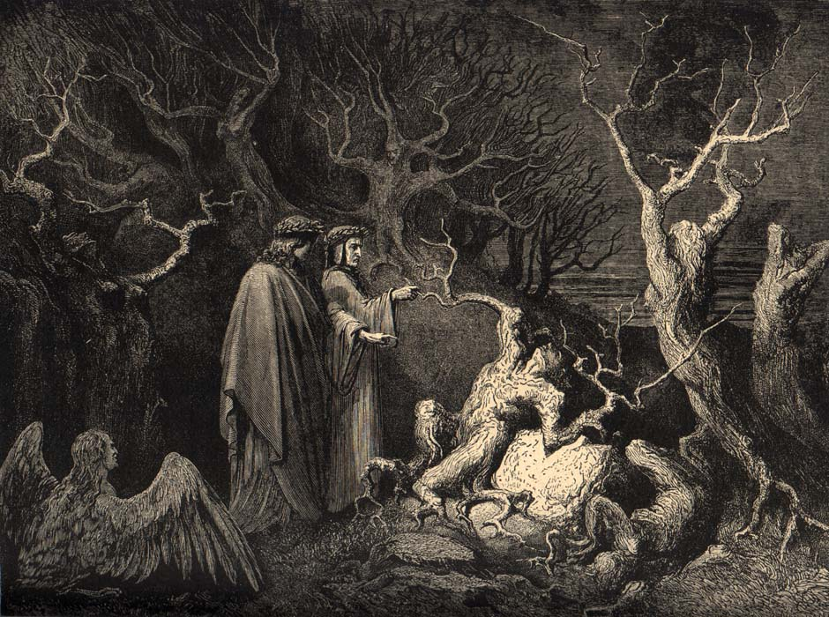
Circle 7: The Violent

Slide 15
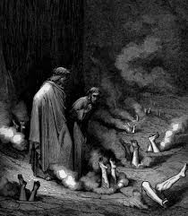
Circle 8: FRAUD

Slide 16
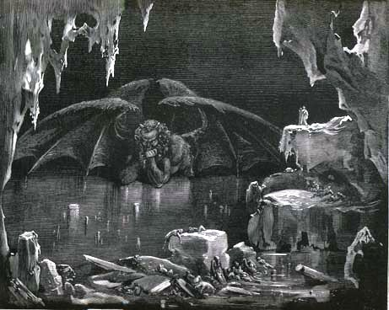
Circle 9: Treachery

