Slide 1
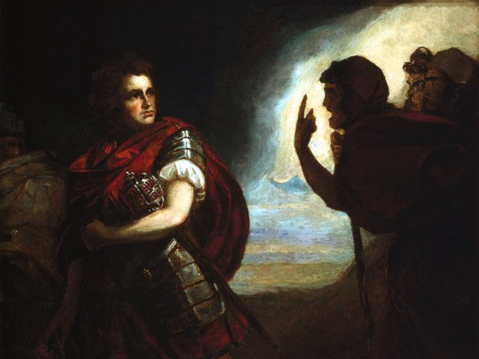
The Tragedy of Macbeth
Lesson 8- Act 3, Scenes 4-6

Slide 2
Activator- Shakespeare’s Ghosts

Slide 3
Ghosts In Shakespeare's Time

Slide 4
Activity 1- Close Reading of 3.4

Slide 5
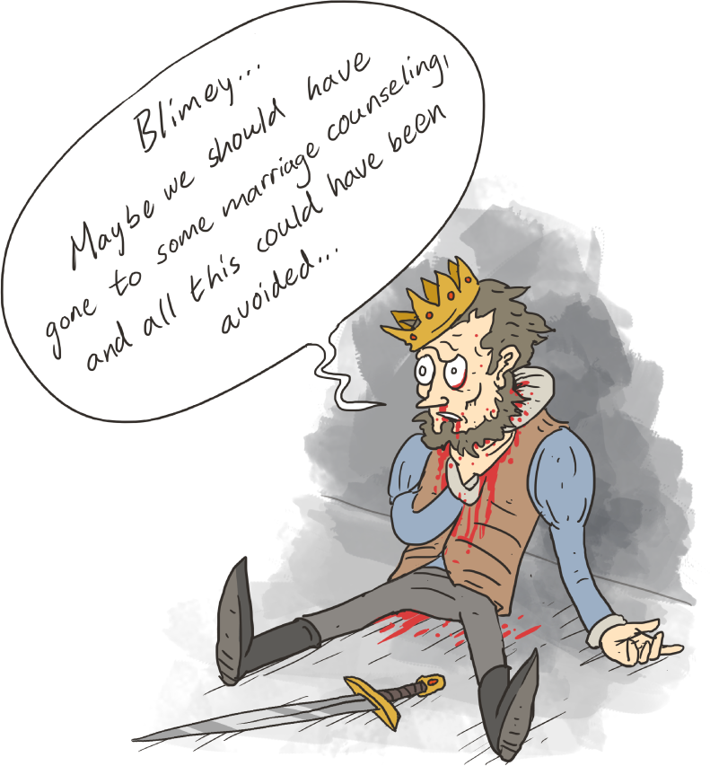
Class Discussion
Class Discussion: How has becoming a murderer changed Macbeth as a person? You will brainstorm with a group and then share your thoughts in small discussion groups.

Slide 6
Activity 2- Close Reading of 3.5 Hecate is ANGRY

Slide 7
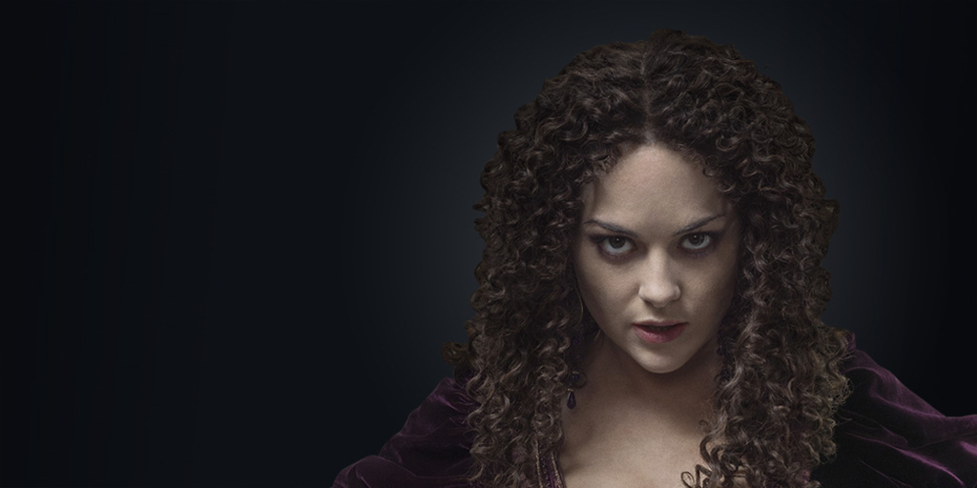
Annotation Skills
Using Hecate’s speech, annotate the reasons she is angry and place your thoughts beside the text.

Slide 8
Activity 3- What is the Purpose? 3.6

Slide 9
What is the Purpose?
After reading 3.6 determine what purpose the scene has for the reader.

