Slide 1
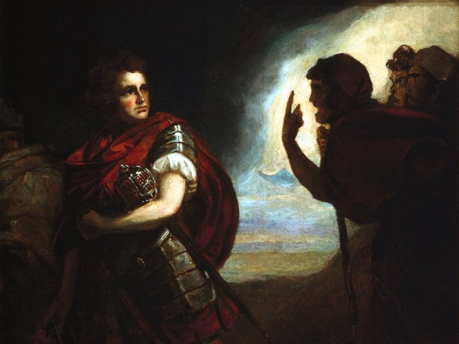
The Tragedy of Macbeth
Lesson 9- Act 4, Scenes 1-2

Slide 2
Activator- The Witches’ Chant

Slide 3
Activity 1- Close Reading of 4.1

Slide 4
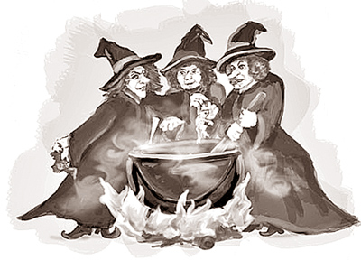
The Prophecies- Part 2
 | Appearance | Prophecy
Apparition 1
Apparition 2
Apparition 3
Apparition 4

Slide 5
Text Analysis:
What does Macbeth decide to do to Macduff after finding out that Macduff has fled to England?

Slide 6
Activity 2- Definition of a Traitor?

Slide 7
Define Traitor in Your Own Words:

Slide 8
Was Macduff a Traitor?

Slide 9
SON Was my father a traitor, mother?
LADY MACDUFF Ay, that he was.
SON What is a traitor?
LADY MACDUFF Why, one that swears and lies.
SON And be all traitors that do so?
LADY MACDUFF Every one that does so is a traitor
and must be hanged.
SON And must they all be hanged that swear and lie?
LADY MACDUFF Every one.
SON Who must hang them?
LADY MACDUFF Why, the honest men.
SON Then the liars and swearers are fools, for there
are liars and swearers enough to beat the honest
men and hang up them.

Slide 10
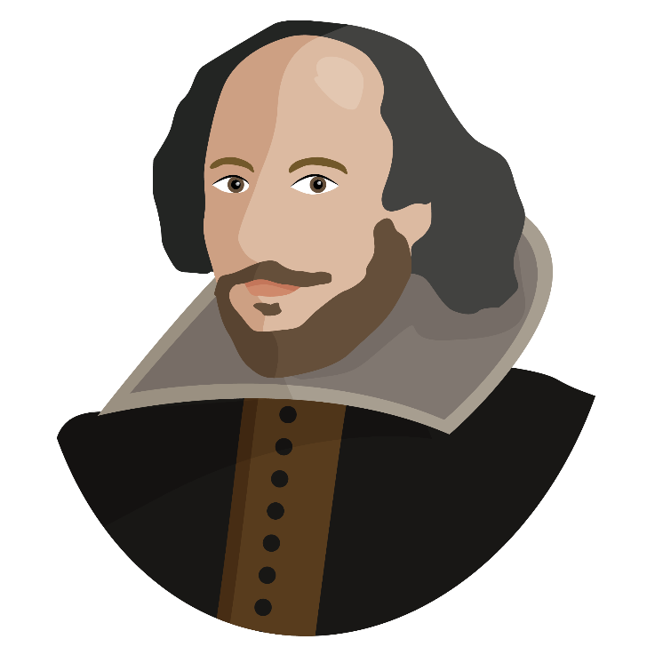
Writing Time:
Was Macduff a traitor? Defend your answer with text based evidence.

