Slide 1
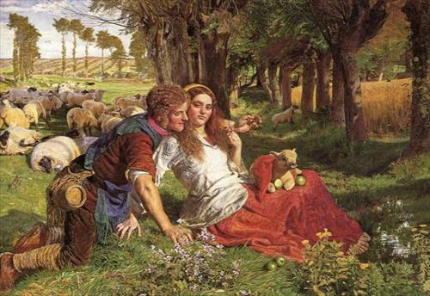
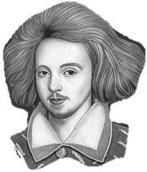
Tis I, Christopher Marlowe, friend and foe of little Will Shakespeare, who wrote this masterpiece.
The Passionate Shepherd to His Love

Slide 2
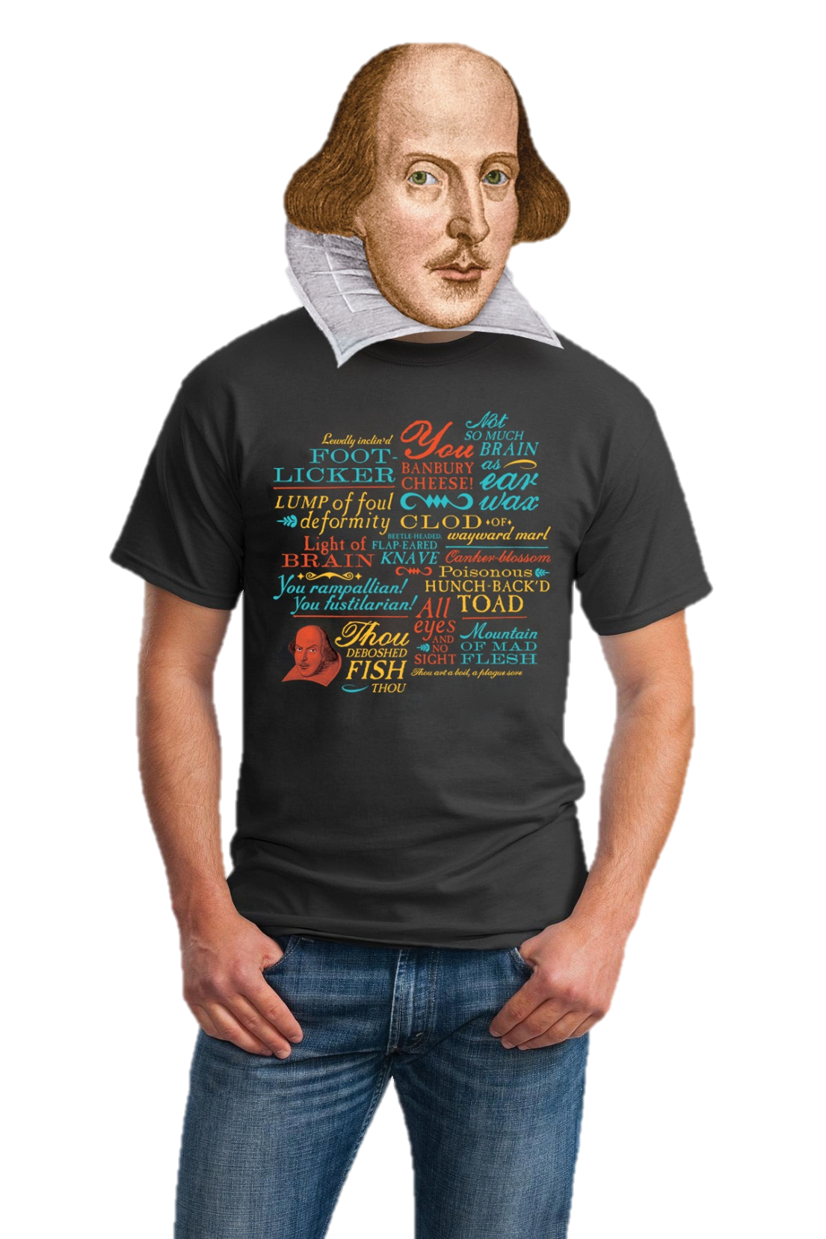
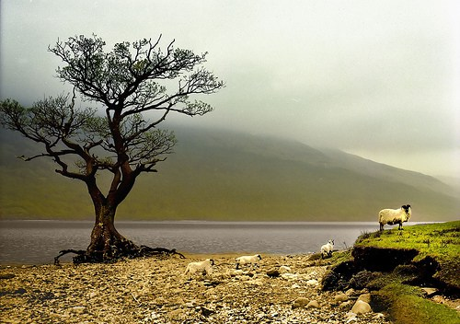
Thou reeky unwash'd blind-worm!
Indeed, I am quite the bad boy of the Elizabethan era.
Then watch this and weep, thou fawning full-gorged boar-pig!
video
Notes:
Video: https://www.youtube.com/watch?v=5CbWeIkgF-g

Slide 3
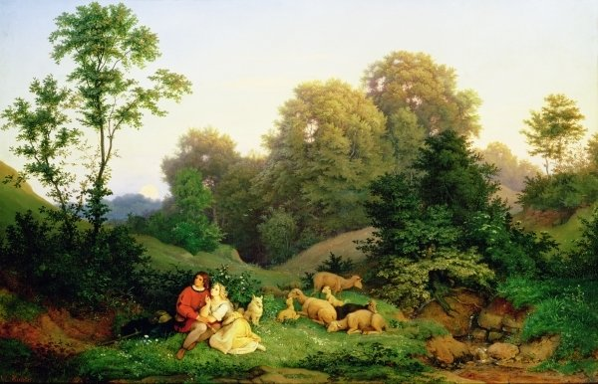
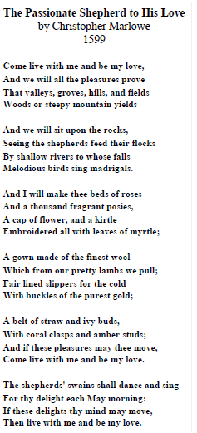
The Passionate Shepherd to His Love
Pastoral Lyric
Poetry that expresses emotions in an idyllic setting. It is related to the term "pasture," and is associated with shepherds writing music to their flocks. The tradition goes back to David in the Bible and Hesiod the Greek poet.
Theme
According to the speaker, we should all learn to Carpe diem! and to satisfy our immediate gratifications—in this case, it’s our sexual passions—don’t do this though. Wait until you are married!
Allusion
“Love in the May countryside” will be like a return to the Garden of Eden. Marlowe believed that there is a tradition that our problems are caused by having too many restrictions—by society, of course. If we could get away from these rules, we could return to a pristine condition of happiness. The "free love" movement of the 1960s was a recent manifestation of this utopian belief. If the nymph (his beloved) would go a-maying with the shepherd, they would have a perfect life, and the shepherd and his beloved could experience the joys of nature for eternity. He hopes to return with the nymph to an Edenic life of free love in nature.
audio
Notes:
Audio: https://www.youtube.com/watch?v=h_F59JL75aQ

Slide 4
The Passionate Shepherd to His Love
1. According to stanza 1, where will the shepherd live with his love?
2. What will her clothes be made of?
3. What will she sleep on?
4. What items from a more glamorous world does the shepherd mention?
5. How old do you think the shepherd is? Why?
6. With what entertainment does the shepherd tempt her?
7. Do you think the shepherd is likely to convince his love with his offers of simple delights? Explain.
8. How do you think his love would reply?
9. As you read this aloud, how many accents are there in each line?
Pastoral Lyric
Poetry that expresses emotions in an idyllic setting. It is related to the term "pasture," and is associated with shepherds writing music to their flocks. The tradition goes back to David in the Bible and Hesiod the Greek poet.
Theme
According to the speaker, we should all learn to Carpe diem! and to satisfy our immediate gratifications—in this case, it’s our sexual passions—don’t do this though. Wait until you are married!
Allusion
“Love in the May countryside” will be like a return to the Garden of Eden. Marlowe believed that there is a tradition that our problems are caused by having too many restrictions—by society, of course. If we could get away from these rules, we could return to a pristine condition of happiness. The "free love" movement of the 1960s was a recent manifestation of this utopian belief. If the nymph (his beloved) would go a-maying with the shepherd, they would have a perfect life, and the shepherd and his beloved could experience the joys of nature for eternity. He hopes to return with the nymph to an Edenic life of free love in nature.

Slide 5
The Passionate Shepherd to His Love
1. According to stanza 1, where will the shepherd live with his love?
2. What will her clothes be made of?
3. What will she sleep on?
4. What items from a more glamorous world does the shepherd mention?
5. How old do you think the shepherd is? Why?
6. With what entertainment does the shepherd tempt her?
7. Do you think the shepherd is likely to convince his love with his offers of simple delights? Explain.
8. How do you think his love would reply?
9. As you read this aloud, how many accents are there in each line?
Pastoral Lyric
Poetry that expresses emotions in an idyllic setting. It is related to the term "pasture," and is associated with shepherds writing music to their flocks. The tradition goes back to David in the Bible and Hesiod the Greek poet.
Theme
According to the speaker, we should all learn to Carpe diem! and to satisfy our immediate gratifications—in this case, it’s our sexual passions—don’t do this though. Wait until you are married!
Allusion
“Love in the May countryside” will be like a return to the Garden of Eden. Marlowe believed that there is a tradition that our problems are caused by having too many restrictions—by society, of course. If we could get away from these rules, we could return to a pristine condition of happiness. The "free love" movement of the 1960s was a recent manifestation of this utopian belief. If the nymph (his beloved) would go a-maying with the shepherd, they would have a perfect life, and the shepherd and his beloved could experience the joys of nature for eternity. He hopes to return with the nymph to an Edenic life of free love in nature.
Do you consider the Shepherd to be a romantic?
What does it mean to be “romantic”?
What aspects of rural life does the Shepherd use to entice his love?
Which things that he describes are unlikely to be found in the pastoral life?

Slide 6
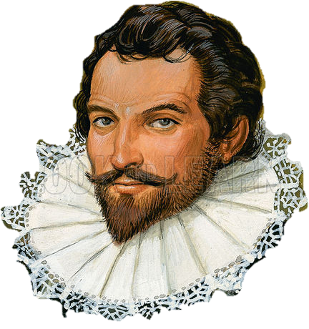
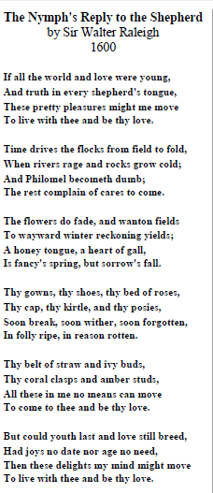
The Nymph’s Reply to the Shepherd
audio
Notes:
Audio: https://www.youtube.com/watch?v=rE-_wzTP1Rk

Slide 7
The Nymph’s Reply to the Shepherd
I, Sir Walter Raleigh, argue that it is not society that taints love. We are already tainted before we enter society.
I combine carpe diem with tempus fugit (time flies) in an unusual way.
Time does not stand still—winter inevitably follows the spring—therefore, we cannot act on impulses until we have examined the consequences.
Consequences!
The world is not young. We are not in Eden but in this old fallen world—a world in which shepherds have actually been known to lie to their nymphs. Marlowe’s utopian society can never exist.
Yes, I am Debbie-Downer.
Notes:
Audio: https://www.youtube.com/watch?v=rE-_wzTP1Rk

Slide 8
The Nymph’s Reply to the Shepherd
The feminine persona (the nymph) sets up a hypothetical set of questions that undermines the intelligence of the man's offer because all that he offers is temporary.
She reverses his images into negative ones:
rocks grow cold,
fields fail for the harvest,
flocks die in the winter,
rivers rage, and
birds complain of winter.
We live in a fallen world, she states. Free love in the grass is impossible now because the world is not in some eternal spring. The seasons pass—as does time. Nymphs grow old, and shepherds grow cold. Ouch!
I, Sir Walter Raleigh, argue that it is not society that taints love. We are already tainted before we enter society.
I combine carpe diem with tempus fugit (time flies) in an unusual way.
Time does not stand still—winter inevitably follows the spring—therefore, we cannot act on impulses until we have examined the consequences.
Consequences!
The world is not young. We are not in Eden but in this old fallen world—a world in which shepherds have actually been known to lie to their nymphs. Marlowe’s utopian society can never exist.
Yes, I am Debbie-Downer.

Slide 9
The Passionate Shepherd to His Love
The Nymph’s Reply to the Shepherd
Carpe diem!
Tempus fugit.
Love is a cough drop that you choke on.

